Slide 1
How to convert Cyclistic casual users into members?
Presented by: Carlos de la Rosa
Last updated: June 21st, 2024

Slide 2
Table of contents
1. Introduction: How do annual members and casual riders use Cyclistic bikes differently?
2. Analysis: Age and trip duration differences between members and casual users.
3. Conclusions: How to maximize memberships among Cyclistic users.

Slide 3
Introduction
Objective: How can we maximize annual memberships among Cyclistic riders?
Question to data: How do the usage patterns of annual members differ from those of casual riders?
Through the analisis of our dataset: Cyclistic trips from 1st quarter of 2019

Slide 4
Analysis
How do the usage patterns of annual members differ from those of casual riders?
A) Usertype vs. Age
B) Usertype vs. Trip duration

Slide 5
Analysis
How do the usage patterns of annual members differ from those of casual riders?
A) Usertype vs. Age
B) Usertype vs. Trip duration

Slide 6
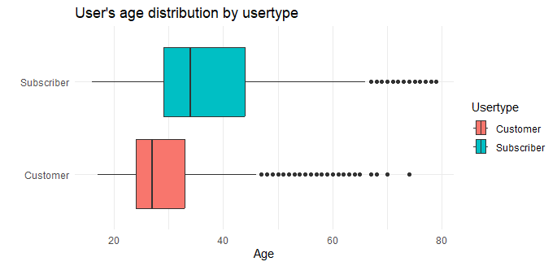
Analysis
A) Usertype vs. Age
50%

Slide 7
Analysis
A) Usertype vs. Age
75%
25%
50%

Slide 8
Analysis
A) Usertype vs. Age
Subscribers are considerably
older than casual users.
75%
25%
50%

Slide 9
Analysis
A) Usertype vs. Age
Subscribers are considerably
older than casual users.
Data are incomplete:
99,7% for subscriber rides
26,1% for casual rides
75%
25%
50%

Slide 10
Analysis
How do the usage patterns of annual members differ from those of casual riders?
A) Usertype vs. Age
B) Usertype vs. Trip duration

Slide 11
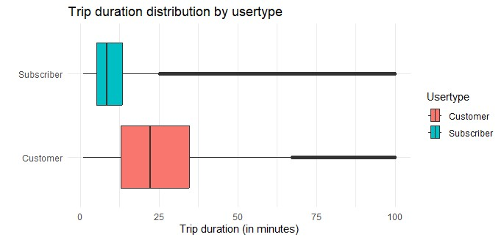
Analysis
B) Usertype vs. Trip duration
25%
75%

Slide 12
Analysis
B) Usertype vs. Trip duration
Trips lasting 13 minutes or less account for
75% of subscriber trips,
but only 25% of casual users trips
Non-subscriber rides are statistically
way longer than subscriber rides.
25%
75%

Slide 13
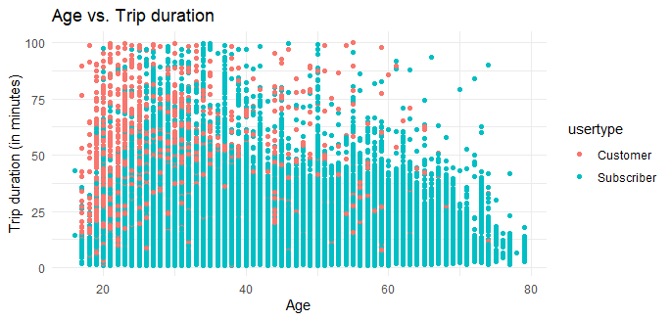
Analysis
Negative correlation
between age and trip duration:
The younger the user,
the longer the ride.

Slide 14
Analysis
Negative correlation
between age and trip duration:
The younger the user,
the longer the ride.

Slide 15
Conclusions
Limitations of our analysis:
1) Sample Representation: While the data on the age of casual riders, accounting for 26% of the total, provides a fairly reliable snapshot, conducting more comprehensive surveys could enhance confidence in our results.
2) Fare Information: We lack details on the fares charged for short and long trips, which are crucial for understanding users' choices and usage patterns of the service.

Slide 16
Conclusions
1. Membership growth can be maximized by targeting young users and long-ride users, who statistically make up the majority of casual riders.
2. These two groups often overlap; young users tend to take longer rides, and long-ride users are frequently younger.

Slide 17
Conclusions
1. Membership growth can be maximized by targeting young users and long-ride users, who statistically make up the majority of casual riders.
2. These two groups often overlap; young users tend to take longer rides, and long-ride users are frequently younger.
So…
How to maximize memberships among Cyclistic users?

Slide 18
Conclusions
Consider offering discounted subscriptions to younger users, such as those under 28 years old. In this scenario, less than 25% of current subscribers would be impacted, but more than 50% of casual riders could be influenced.
Increasing the prices for long rides could encourage long-ride users to become subscribers. Trips of 13 minutes or less account for 75% of subscriber trips, but only 25% of casual users' trips.

Slide 19
Conclusions
These two business strategies could be effective on their own.
However, implementing them together might create a 'pincer effect,' potentially persuading young and long-trip users to transition from casual riders to subscribers.

Slide 20
Thanks.

